Slide 1
Diode model
Weijing Liu

Slide 2
Outline
Basic theory
Layout
Measurement
Extraction
QA
Document

Slide 3
Theory
Structure for diode
Type of diode :
N+/Pwell
Nwell/Pwell
P+/Nwell
Type of Cjgate

Slide 4
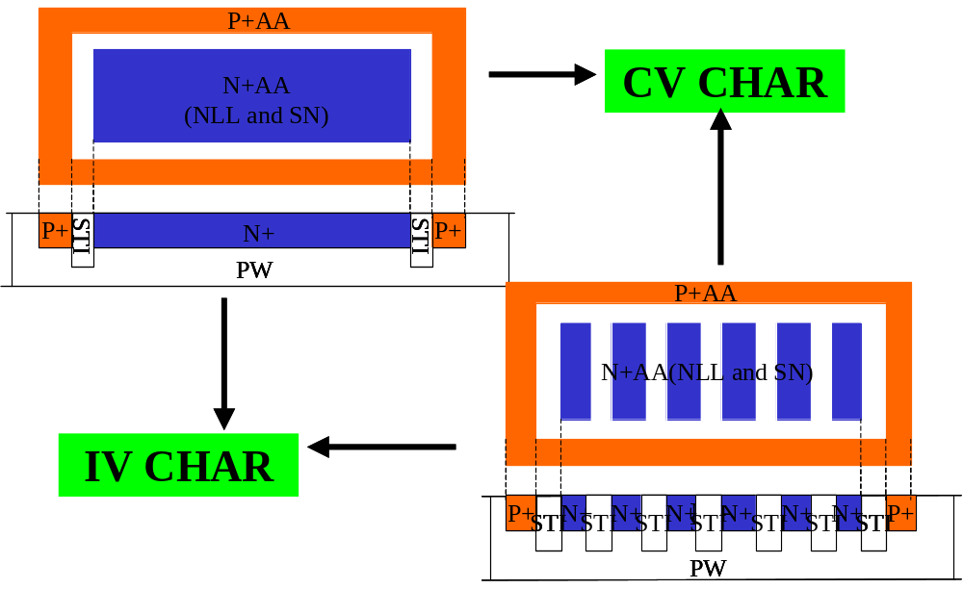
Diode Layout structures(eg.n+pwell)

Slide 5
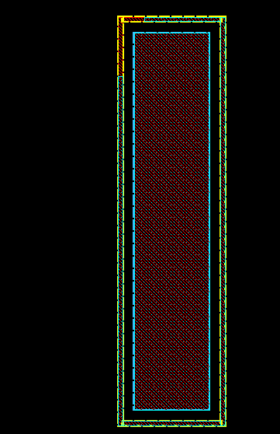
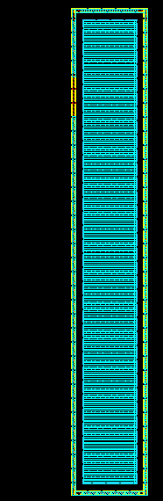
N+/Pwell_Area
N+/Pwell_Finger

Slide 6
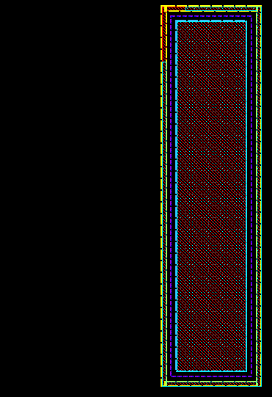
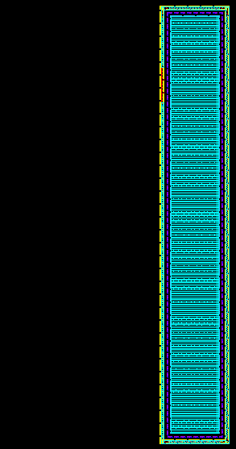
Nwell/Pwell_Area
Nwell/Pwell_Finger

Slide 7
Measurement
Make sure all the junction diode types need to be modeled, in general, including: N+/Pwell,P+/Nwell and etc.
To do I-V and C-V measurement, using small area device for IV and large area device for CV. For I-V: bias voltage from -2 ~ 1.2V (1.2V is the at least voltage and you can increase the end voltage value to ensure current value reaches 100mA); For C-V: bias voltage from 0 ~ 3.6V.
Measurement items also including: breakdown voltage (choose area junction); cjgate and cgdo. (cjgate and cgdo using the same pattern)
All the above items need 5 temperature (25c, 125c, 85c, -15c and –40c), except for breakdown voltage, CV for cjgate and cgdo.

Slide 8
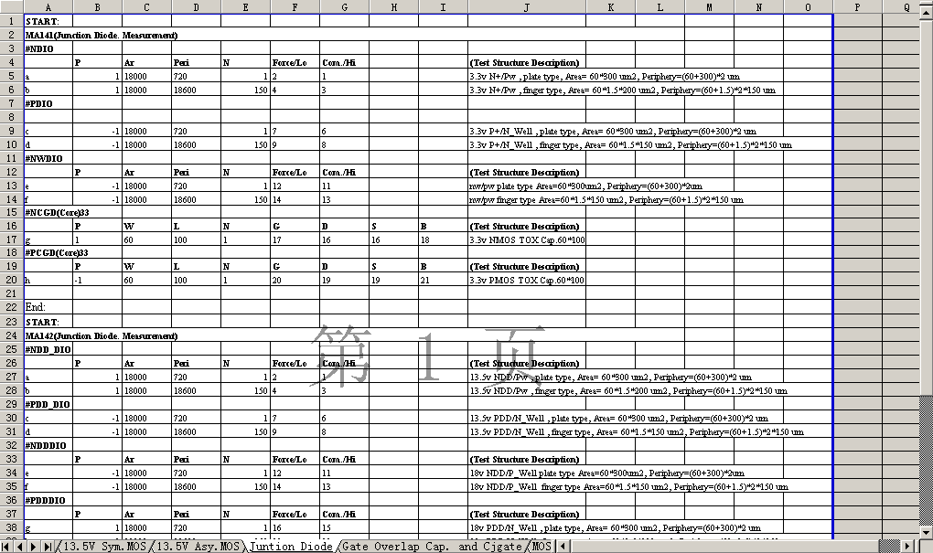
Testkey

Slide 9
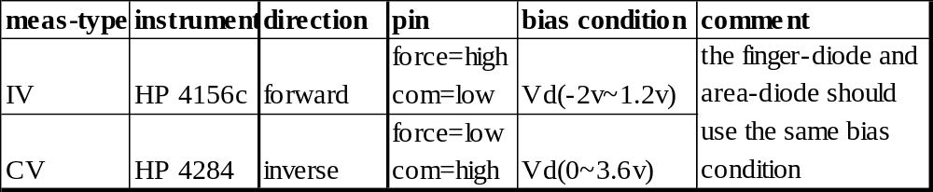
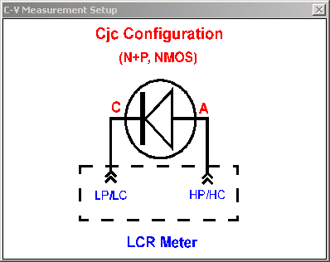
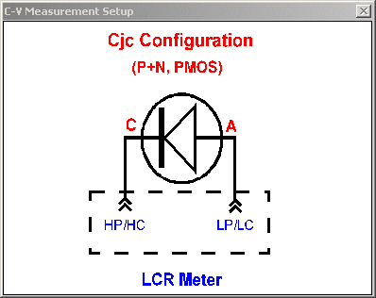
Diode IV/CV measurement condition
Both area and finger

Slide 10
Measure BV
We measure BV after diode parameters extraction completed.
select area junction.
Select voltage is nearest 1E-06A current.so compliance current is 1E-05A.

Slide 11
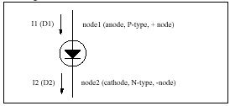
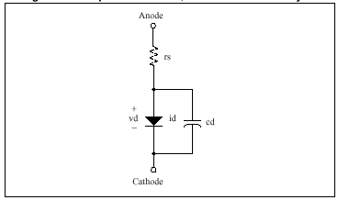
Diode characterization –model circuit

Slide 12
Diode Model Extraction(SMEDA)
Parameter extraction procedure:
  2.1.Select diode type.
  2.2.Select normal temperature(25c) to extract
  2.3.Select all data to extract temperature coefficient

Slide 13
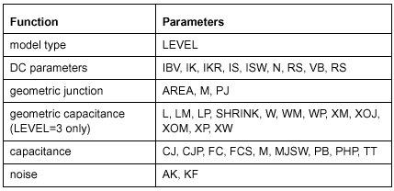
Diode characterization –model parameters

Slide 14
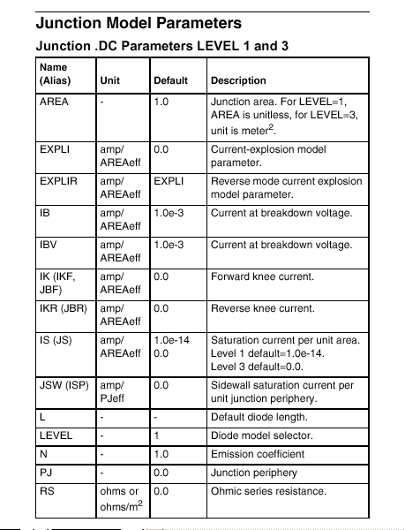
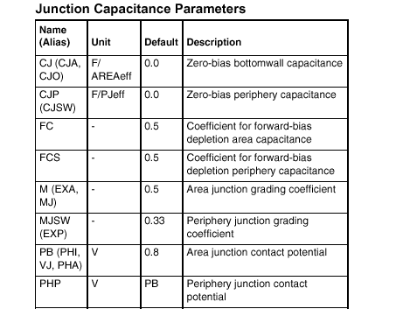
Parameter Description

Slide 15
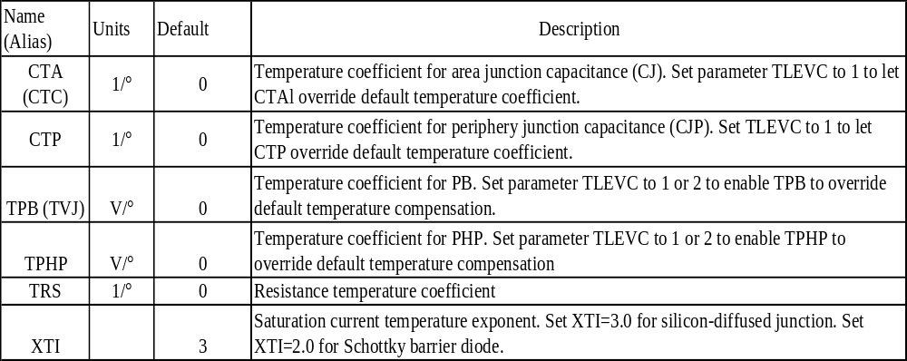
Parameter Description-temperature

Slide 16
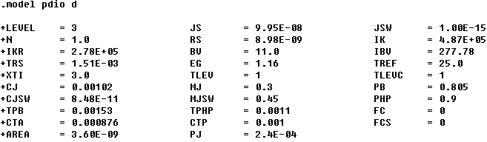
Diode characterization –model-card

Slide 17
Diode modeling-IV

Slide 18
The main parameters for diode IV

Slide 19
The main parameters for diode CV

Slide 20
The main parameters for diode CV

Slide 21

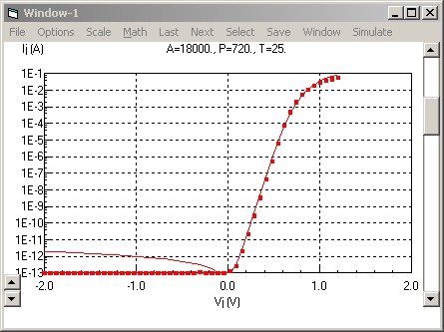
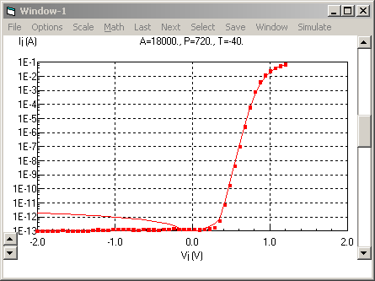
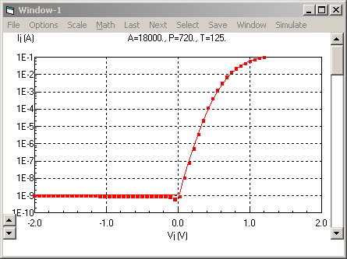
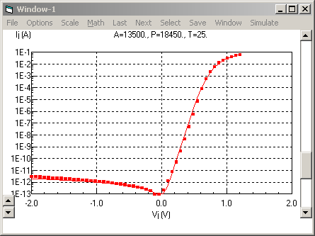
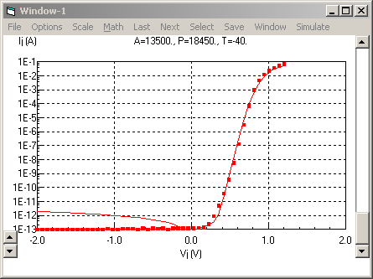
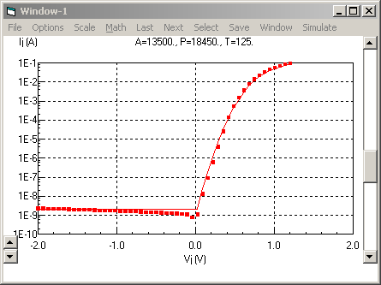
The fitting of diode IV
RS
TRS
Area
JS
STI
Finger
JSW

Slide 22

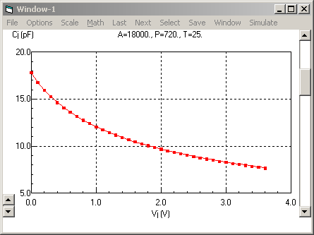
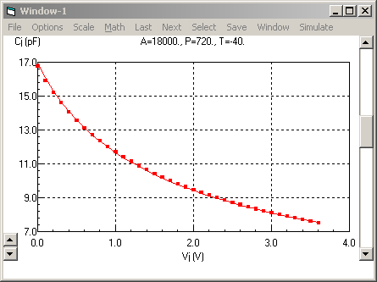
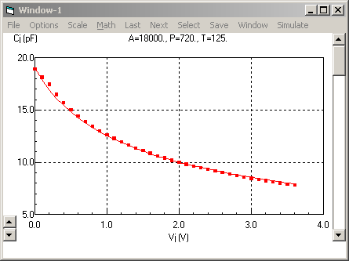
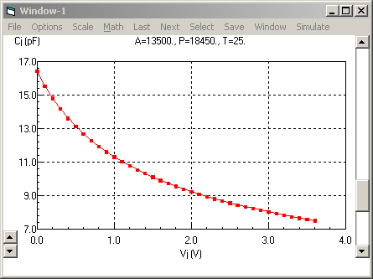
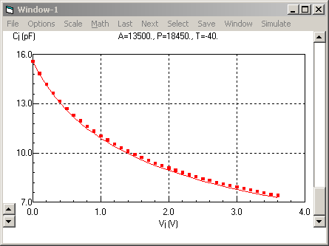
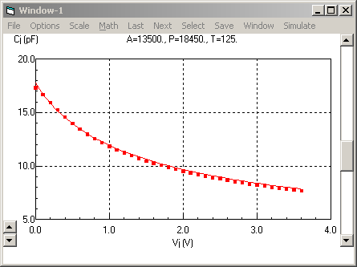
The fitting of diode CV
Area
CJ
CTA
PB
TPB
MJ
Finger
CJSW
CTP
PHP
TPHP
MJSW

Slide 23
The note to diode modeling
The whole procedure of diode modeling can be depart as the following step:
1. Check data.
2. IV /CV parameters extraction.including the IV/CV temperature coefficient extraction;
3. IV and CV parameters combination;
4. BV is measurement.
5. IBV=1uA/A(area);IKR=IBV*E+03
6. JSW and STI only need to write down and used in MOS model, SO JSW=1E-15,XTI=3 in model card of the document .

Slide 24
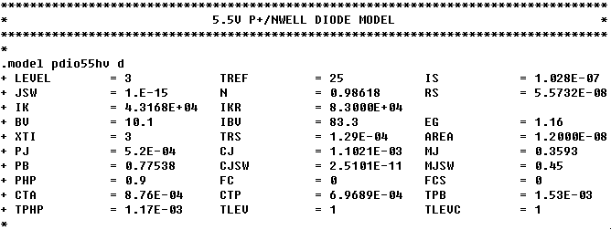
Model card-diode

Slide 25
Document
1. Model-card;
2.The fitting plots of IV and CV curves at different temperature of area structure;
3. The layout data in GDSII format of area structure ;

Slide 26
The note to diode documentation
To help our customer ease to use and understand our models,we often prepare some plots and model usage guide line in the attachment, they are :
1. Model-card fore Spectre and HSPICE;
2.The fitting plots of IV and CV curves at different temperature;
3. The layout data in GDSII format of area structure ;
4.The layer map file;

